Slide 1
Be notified when we launch?
http://eepurl.com/be4SS9

Slide 2









What if we empowered 7.5M small business owners?

Slide 3
$
Most small businesses don't have websites
driving results

Slide 4
Need
Small business owners can make changes to their website content.
Small business owners can hire someone to change their website design.

Slide 5

Death to WordPress
(Working title)

Slide 6
Simpler

Slide 7
Superior Design

Slide 8
Best Practices

Slide 9
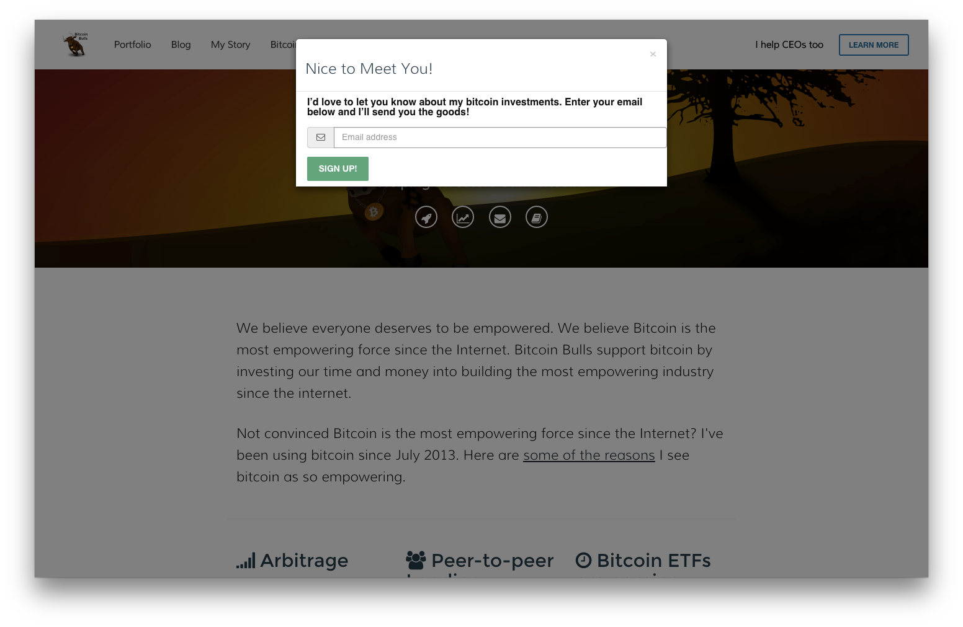
Sample

Slide 10
Small Business Owners Said
How can I sell a monthly newsletter subscription?
I can’t add a product to my website.
My website is useless but I need one.
I asked my web developer to add an image 3 months ago.

Slide 11
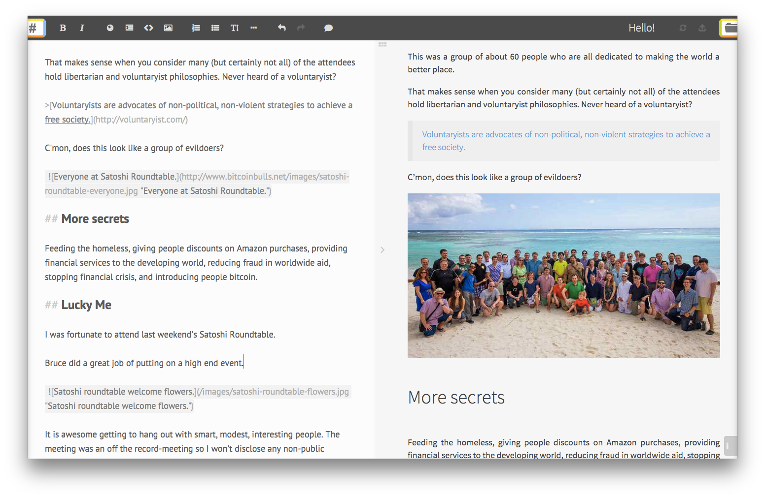
Functioning Content Management System

Slide 12
Architecture supports multiple websites

Slide 13
Fast

Slide 14
Real Time Editor

Slide 15

Executives
CEO
SALES
?

Slide 16
Recruiting
Marketer
Designer
JavaScript developer

Slide 17
Be notified when we launch?
http://eepurl.com/be4SS9

